Slide 1
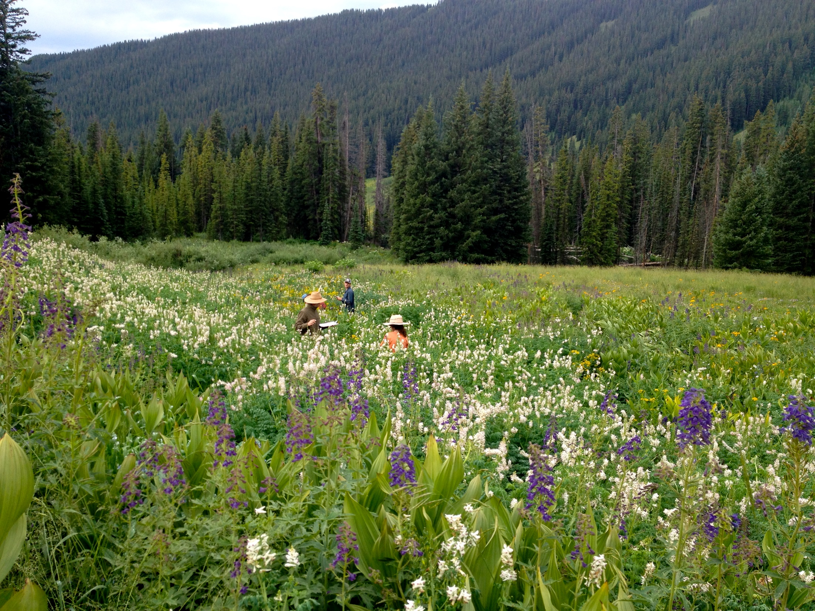
Day 1:
Network structure
Credit: Prof. Judith Bronstein

Slide 2
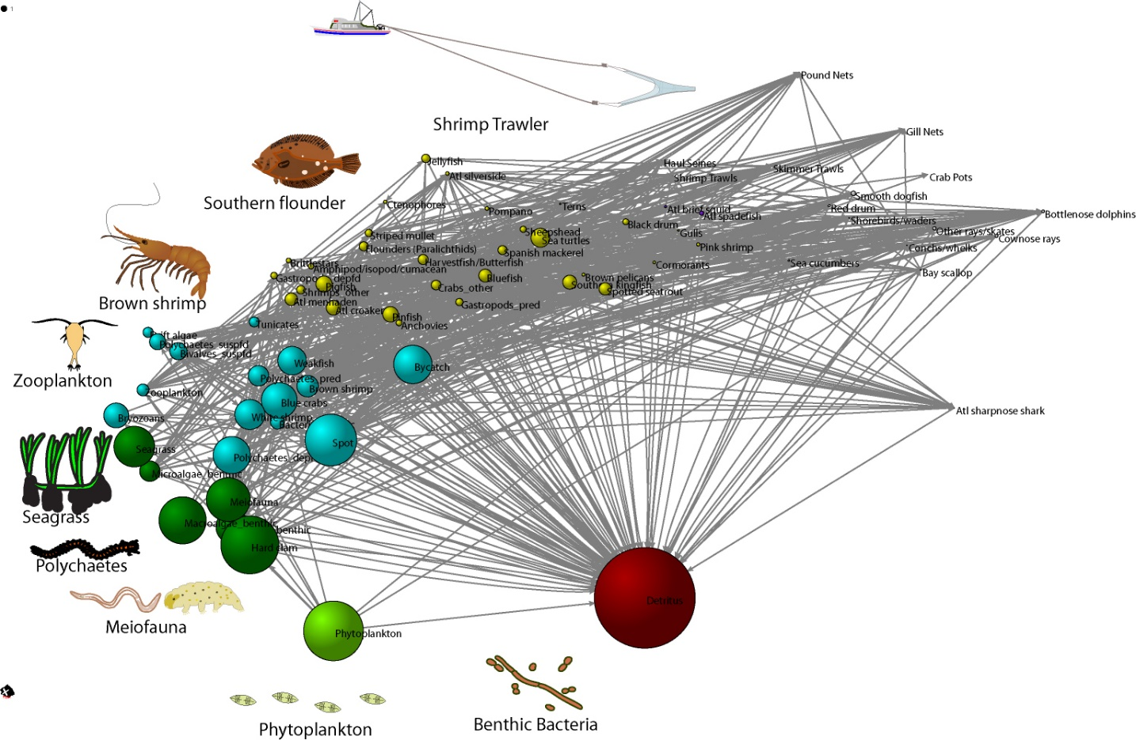
Why networks?
Make ecological complexity more tractable
Allow the study of responses of whole communities to perturbations.
Evaluates the interplay between structure and dynamics and the influence of such interplay on the system responses to perturbations

Slide 3
Credit: Prof. Judith Bronstein

Slide 4
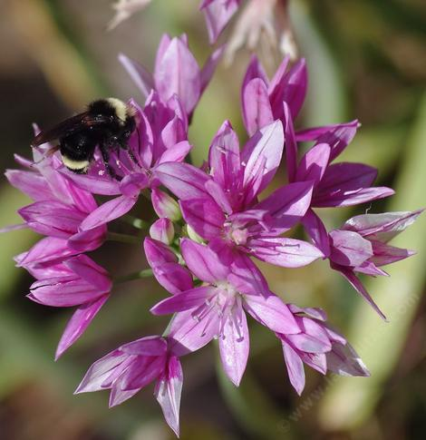
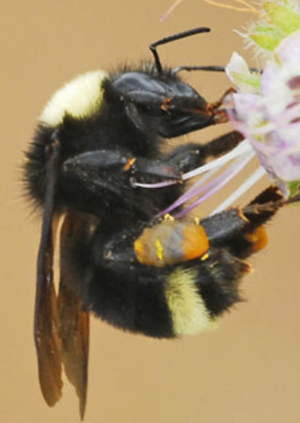

Slide 5
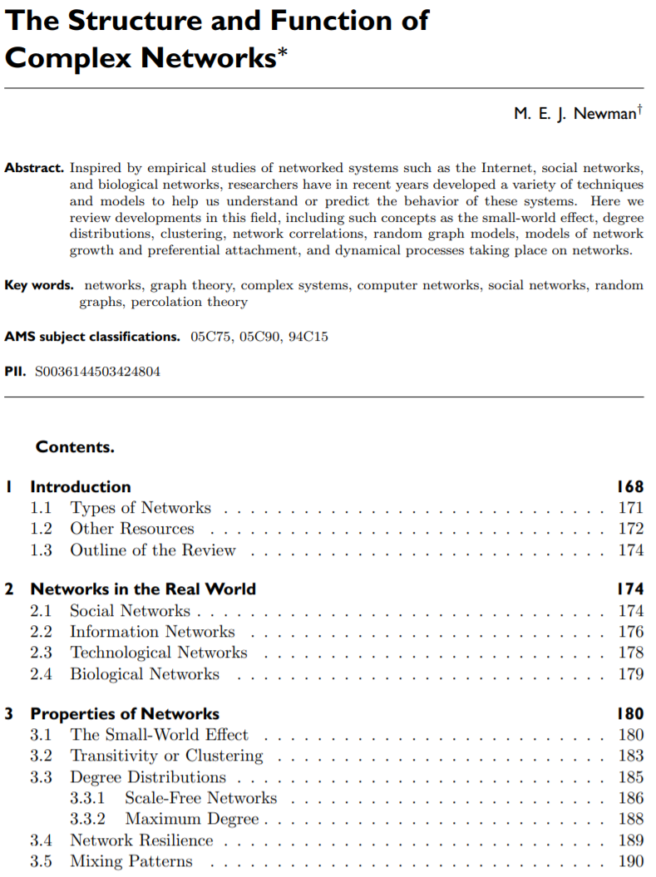


Physics & Complexity Sciences: Complex Networks

Slide 6
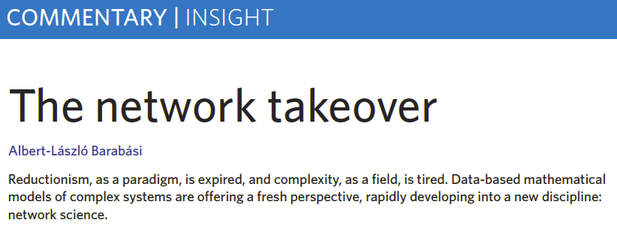
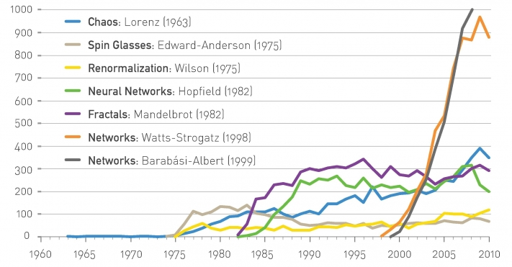
Physics & Complexity Sciences: Complex Networks

Slide 7

Physics & Complexity Sciences: Complex Networks
Main assumption of this field:
“the particular pattern of interactions can have a big effect on the behavior of the system.”
Newman 2010

Slide 8
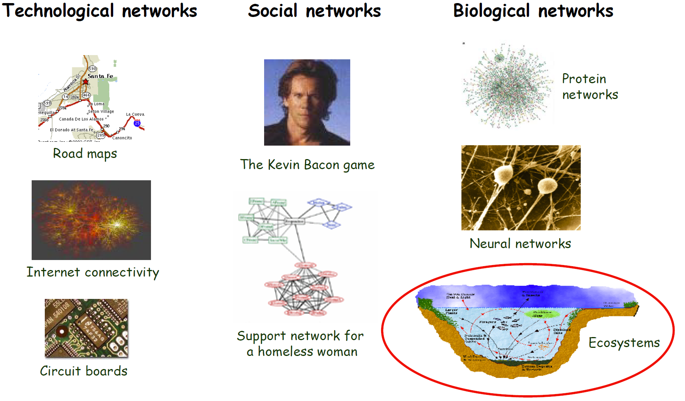
Physics & Complexity Sciences: Complex Networks

Slide 9
Terminology
nodes and edges (links)
directed vs undirected networks
unipartite vs bipartite networks
binary vs weighted networks

Slide 10
Metrics of network structure

Slide 11

Watch Ted Ed Video for a summary of a third of this class
https://ed.ted.com/lessons/how-bees-help-plants-have-sex-fernanda-s-valdovinos
Also in YouTube!

Slide 12
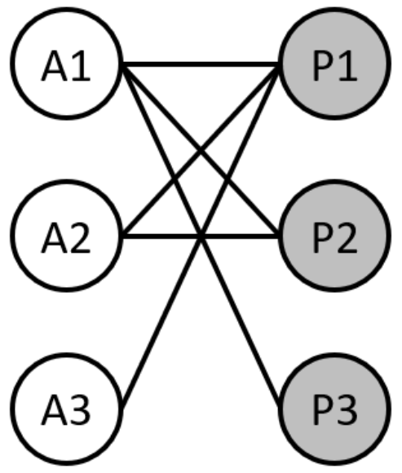
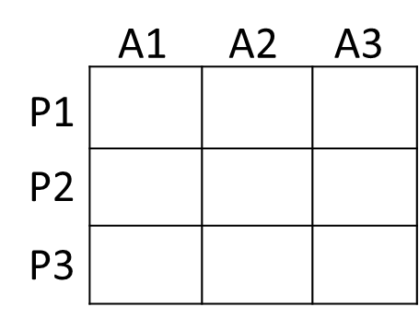
Network Structure
Switching between network and matrix forms
Exercise 1: … draw the corresponding matrix for the network. Assume that matrix rows represent plant species while matrix columns represent animal species.

Slide 13
Network Structure
If a new mutualistic network was sampled in the field, it would likely exhibit:
More animal than plant species
Moderate connectance
Highly heterogeneous degree distribution
High nestedness
Moderate modularity
Asymmetric dependences (interaction frequency)

Slide 14
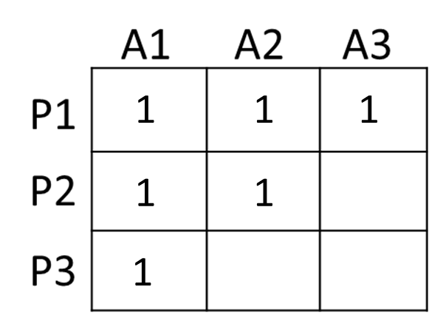
Connectance
Fraction of potential interactions that are realized
Potential number of links?
Realized number of links?
Connectance (C)?
Difference in C calculation between unipartite and bipartite networks?
67% of the potential links are realized

Slide 15
Moderate connectance
= sparse networks
= many potential links not realized

Slide 16
Moderate connectance
= sparse networks
= many potential links not realized
= many empty cells

Slide 17
Network Structure
If a new mutualistic network was sampled in the field, it would likely exhibit:
More animal than plant species
Moderate connectance
Highly heterogeneous degree distribution
High nestedness
Moderate modularity
Asymmetric dependences (interaction frequency)

Slide 18
3) Heterogeneous degree distribution:
Most species have one or a few interactions (specialists) and a few species have most of the interactions in the network (hyper-generalists).
Degree: The total number of interactions for a single species

Slide 19
3) Heterogeneous degree distribution:
Most species have one or a few interactions (specialists) and a few species have most of the interactions in the network (hyper-generalists).
Degree: The total number of interactions for a single species

Slide 20
Degree distribution
More heterogeneous?
1
2
3
sp1
sp5
sp1
sp5
sp1
sp5
sp2
sp6
sp2
sp6
sp2
sp6
sp3
sp7
sp3
sp7
sp3
sp7
sp4
sp8
sp4
sp8
sp4
sp8
More homogeneous
More heterogeneous

Slide 21
Network Structure
If a new mutualistic network was sampled in the field, it would likely exhibit:
More animal than plant species
Moderate connectance
Highly heterogeneous degree distribution
High nestedness
Moderate modularity
Asymmetric dependences (interaction frequency)

Slide 22
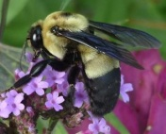
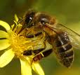

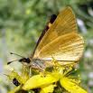




Nestedness
~80% of observed empirical networks are nested
Nested network
Non-nested network

Slide 23
Nestedness

Slide 24
Nestedness

Slide 25
Nestedness

Slide 26
Nestedness
sp5
sp6
sp7
sp8
sp1
sp5
sp1
1 | 1 | 1 | 1
1 | 1
1
1
sp2
sp6
sp2
sp3
sp3
sp7
sp4
sp4
sp8

Slide 27
Nestedness
sp5
sp6
sp7
sp8
sp1
sp5
sp1
 | 1 | 1 | 1
1 | 1
1
1 |  |  | 1
sp2
sp6
sp2
sp3
sp3
sp7
sp4
sp4
sp8
More or less nested?

Slide 28
Modularity
Network compartmentalization into modules, whose species interact more among them than with species belonging to other modules.
Olesen et al 2007

Slide 29
Modularity
1
2
3
sp1
sp5
sp1
sp5
sp1
sp5
sp2
sp6
sp2
sp6
sp2
sp6
sp3
sp7
sp3
sp7
sp3
sp7
sp4
sp8
sp4
sp8
sp4
sp8
2 modules connected by species 1

Slide 30
What are the factors producing these structural properties?

Slide 31
Potential determinants of network structure
Vazquez et al 2007

Slide 32
Barriers or constraints on interaction formation
also called forbidden links
Temporal or spatial uncoupling (i.e., species do not co-occur in either time or space).
Constraints to the accessibility of the resources due to trait mismatches (e.g., proboscis size very different from corolla size).
Physiological-biochemical constraints that prevent the interactions (e.g., chemical barriers).

Slide 33
1. Temporal or spatial uncoupling (i.e., species do not co-occur in either time or space).
Phenophase diagrams show the recorded temporal
span of insect flower visitation and flowering of each species.
Each bar represents a species. Species are sorted according to the starting date
of flowering or foraging, and then according to the end date.
Insect sp.
Plant sp.
Olesen et al. 2008

Slide 34
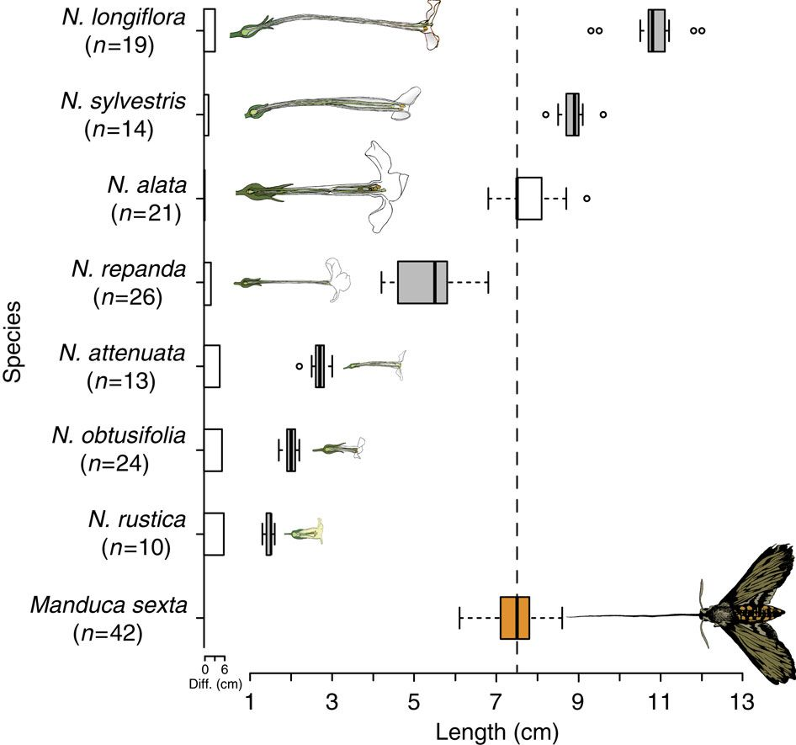
2. Constraints to the accessibility of the resources due to trait mismatches (e.g., proboscis size very different from corolla size).

Slide 35
Schiestl & Johnson2013

Slide 36
But structural properties can be a sampling artefact!!!

Slide 38
Blüthgen et al. developed a neutral model assuming:
Incomplete sampling of species interactions
Skewed species abundances
Fully generalized systems (i.e., all plant species interact with all animal species).
Often-missing interactions between rare species (characteristic of nestedness and heterogeneous degree distributions) result from low sampling efforts failing to record the interactions of rare species.

Slide 39
Notes:
A skewed distribution of species observation records (such as the lognormal), combined with a relatively low sampling density typical for ecological data, already generates a ‘nested’ and poorly ‘connected’ network when interactions are neutral.

Slide 40

Is the observed structure of mutualistic networks represents the ‘true’ architecture of interactions (produced by evolutionary and ecological mechanisms), or merely an artefact of incomplete sampling?

Slide 41
This question promoted many studies investigating sampling effects on network structure by:
Varying sampling effort in the field
Varying sampling effort in models generating network structures
Use of several data sources
Conclusion: incomplete sampling strongly underestimates the number of interactions and degree of generalization, but does not necessarily affect higher-order network properties such as nestedness.

Slide 42
Final Caveat: Relationships among metrics
All these metrics correlate, some positively others negatively.
Critical to keep it mind these correlations when analyzing your data, especially when comparing the structure of several networks, for example across a latitudinal or altitudinal gradient.

Slide 43
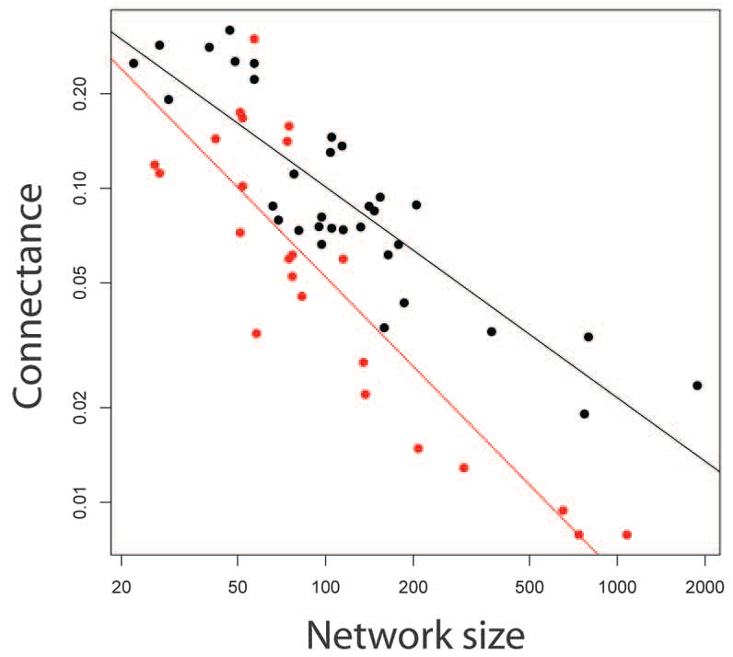
Connectance vs Species richness
The best known of those relationships is the negative correlation between network richness (i.e., number of species) and connectance.
In a way, this relation is somehow obvious from the definition of connectance why?
Thebault & Fontaine 2010 (Science)

Slide 44
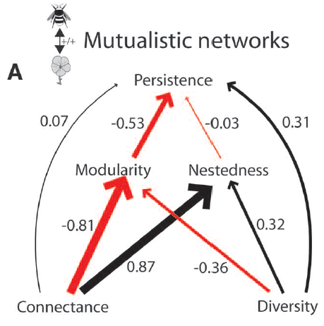
Other relationships among metrics
Thebault & Fontaine 2010 (Science)

Slide 45
Connecting structure to dynamics
Credit: Prof. Judith Bronstein

Slide 46
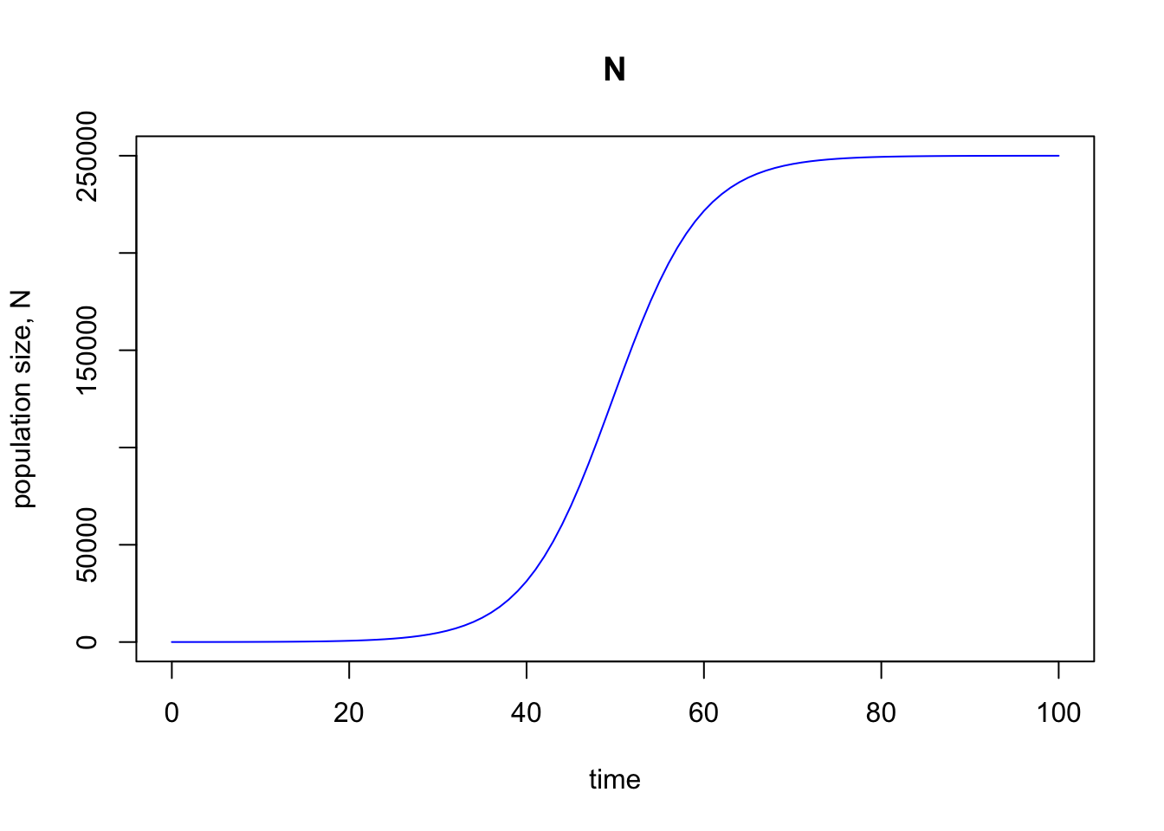
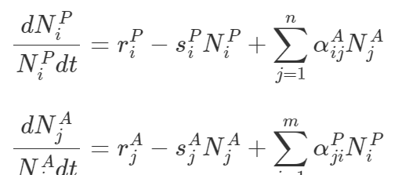
Structure
Dynamics

Slide 47
I’m going to use nestedness as an example, but the same kind of thinking can be used for other metrics…

Slide 48
Nestedness
~80% of observed empirical networks are nested
Nested network
Non-nested network

Slide 49

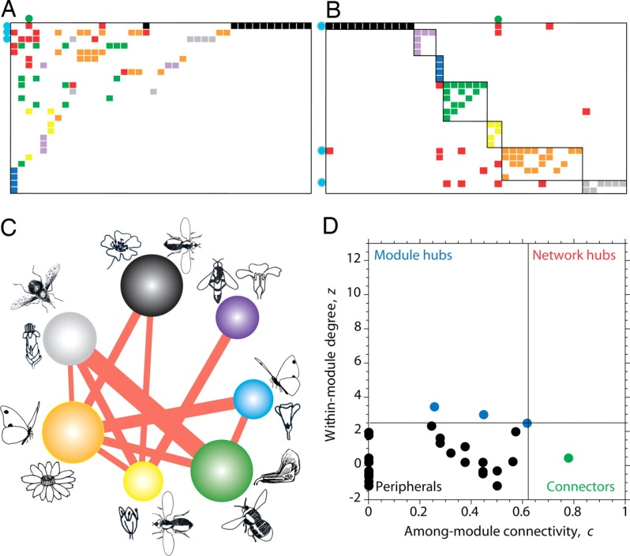
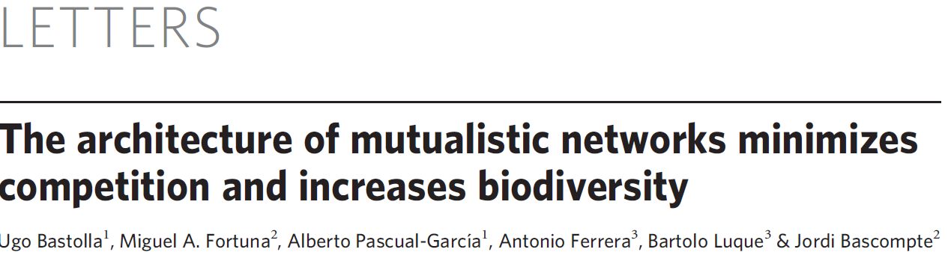

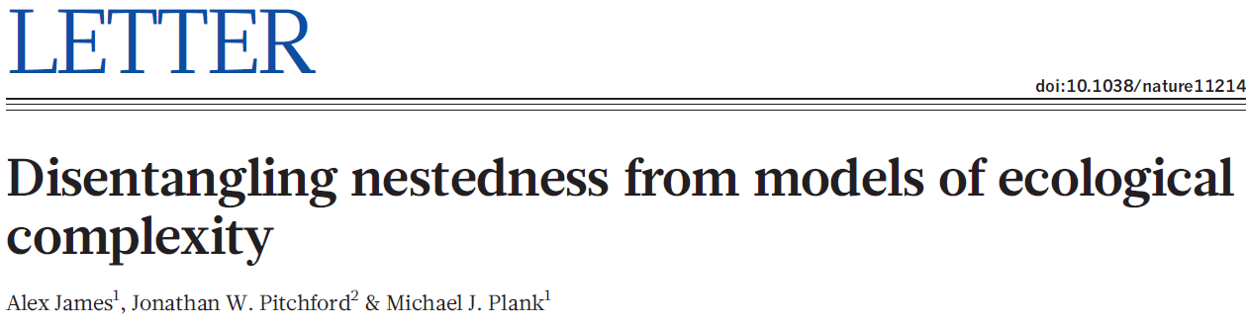

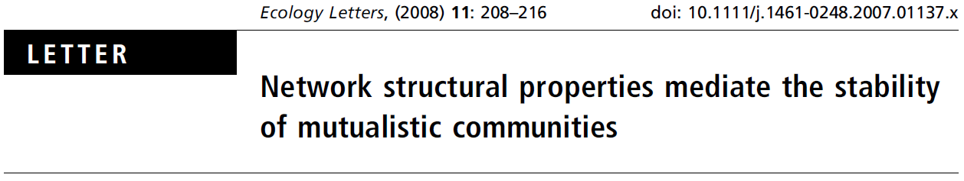
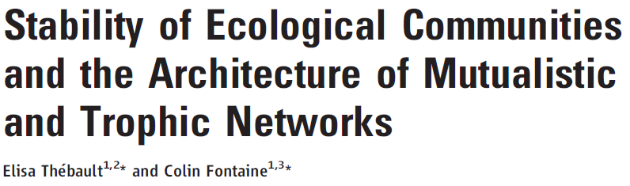
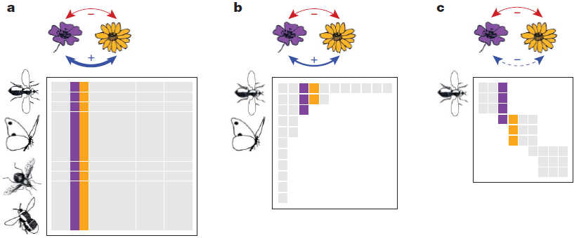
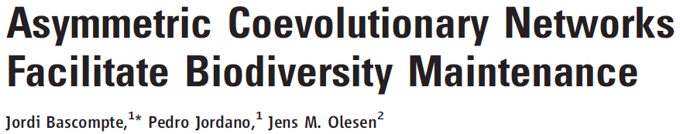
Effect of Nestedness on Networks Stability
Stabilizes
(Okuyama & Holland 2008,
Bastolla et al. 2009,
Thebault and Fontaine 2010)
Destabilizes
(Tang & Allesina 2012, James et al. 2012)

Slide 50
Different stability concepts
Local stability
Resilience
Structural Stability
Feasibility
Species persistence
Robustness against species extinctions

Slide 51
Different stability concepts
Local stability: A system is locally stable if it returns to its original state after being slightly disturbed.
Resilience: Time to return to a local equilibrium after slightly perturbing the system away from it.
Structural Stability: A system is structurally stable if any smooth change in the model itself or in the value of its parameters does not change its dynamic behavior (e.g., existence of equilibrium points, limit cycles, chaos, etc).
Feasibility: All the constituent species from the community attain positive abundances at equilibrium.
Species persistence: Fraction of initial species that persists until the end of the simulations.
Robustness against species extinctions: Resistance of a network to loose more species (as secondary extinctions) as result of primary extinctions, which are typically simulated as the removal of species from the network.

Slide 52
Different processes considered
Pollination services
pollen dilution?
High niche overlap
(pollination services)
Competitive exclusion?

Slide 53
Different processes considered
Floral rewards
High niche overlap
(floral rewards)
Competitive exclusion?

Slide 54
Different processes considered
Lotka-Volterra type models
(+,+)
(+,+)
Population Dynamic (+,+) models:
Bastolla et al. 2009,
Thebault and Fontaine 2010
Rohr et al. 2014

Slide 55
Different processes considered
Pollination services
Feeding interactions
(+,+)
Valdovinos et al. (2013), Oikos
Valdovinos et al. (2016), Ecology Letters

Slide 56
Consumer-resource dynamic model
Rewards
rewards consumption
production
pollination
Adaptive Forager
Assigns higher foraging effort to plants with more floral rewards
Rewards
Valdovinos et al. (2013), Oikos
Valdovinos et al. (2016), Ecology Letters

Slide 57
Without adaptive foraging
Rewards
Valdovinos et al. (2016), Ecology Letters

Slide 58
Without adaptive foraging
Rewards
Valdovinos et al. (2016), Ecology Letters

Slide 59
With adaptive foraging
Rewards
Valdovinos et al. (2016), Ecology Letters

Slide 60

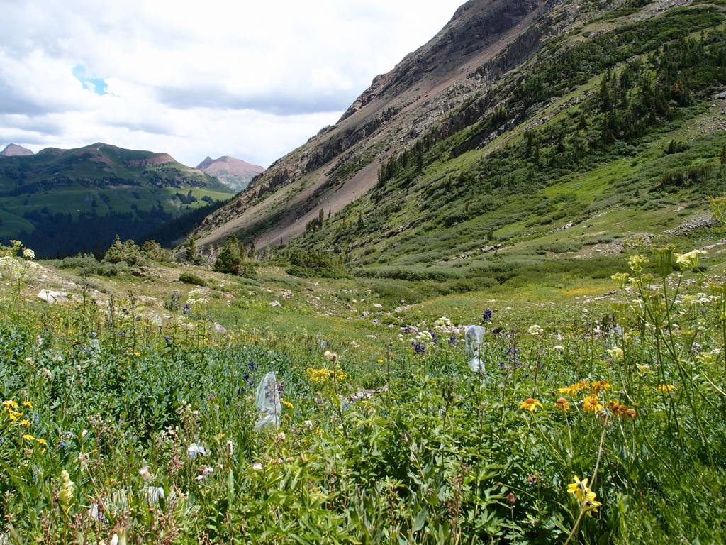
Testing theory with empirical data
Empirical data:
>30,000 visits
>1000 bumble bees, 8 spp
Colorado, Rocky Mountain Biological Lab
PREDICTION:
Pollinators prefer
specialist plants
Berry Brosi
Individual’s normalized foraging effort
( log[normalized foraging effort] )
Plant generality (# pollinator species)
Valdovinos et al. (2016), Ecology Letters
Notes:
We did the same regression for our empirical data that include over 30,000 visits by over 1000 bumble bees foraging in field sites around the Colorado Rocky Mountain Biological Lab. Alpine plant community
Lines depict best-fit estimates from linear mixed-effects models, with the 95% CIs shaded. Model data consist of 200 nested networks with average species richness S = 90 and average connectance C = 0.15.

Slide 61
Testing theory with empirical data
PREDICTION:
Pollinators prefer
specialist plants
Individual’s normalized foraging effort
( log[normalized foraging effort] )
Plant generality (# pollinator species)
Notes:
Lines depict best-fit estimates from linear mixed-effects models, with the 95% CIs shaded. Model data
consist of 200 nested networks with average species richness S = 90 and average connectance C = 0.15.

Slide 62
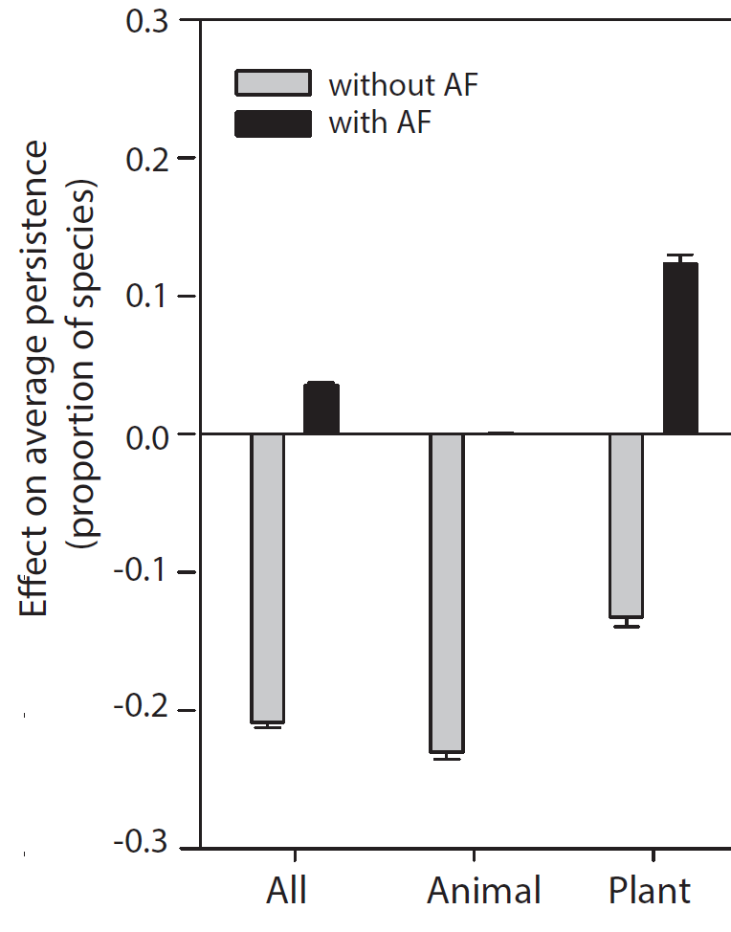
Adaptive foraging (AF) reverses the effect of nestedness on species persistence
Without adaptive foraging
With adaptive foraging
Resolution of the debate:
Nestedness destabilizes AND stabilizes
AF may explain why nested networks in nature can persist
Effect of nestedness on average persistence
(proportion of species)
Valdovinos et al. (2016), Ecology Letters

